Slide 1
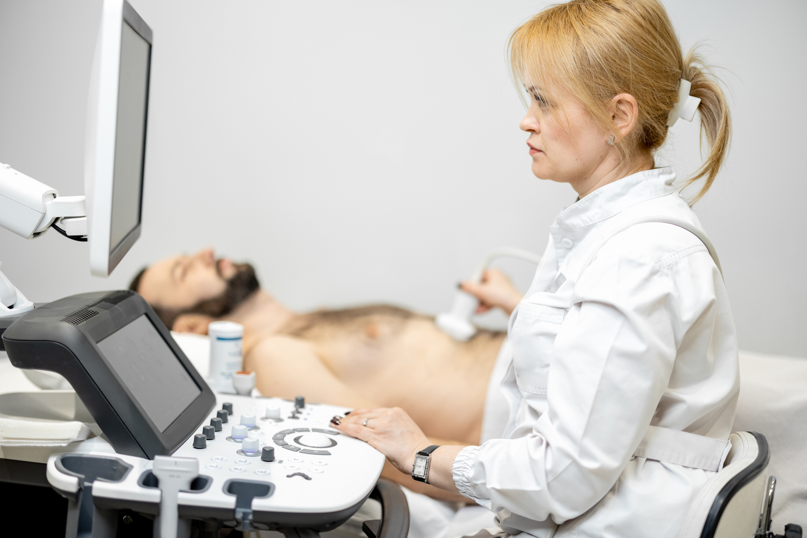

HCC Ultrasound Surveillance:
Latest guidelines & What you need to know
Dr Ruth Reeve, PhD

Slide 2

HCC Ultrasound Surveillance
  HCC is the most common liver cancer
  HCC fastest rising cause of cancer related deaths in UK
  HCC Surveillance aims to identify cancers early to allow cancer treatment at curative stages
  NICE guidance recommends 6 monthly US for individuals at risk of developing HCC
Notes:
Hepatocellular carcinoma (HCC) is the most common primary liver cancer and the fastest-rising cause of cancer related deaths in the UK (1).
The principle of cancer surveillance is to repeatedly test at-risk individuals , based on the premise that detection of cancer at an early stage allows the receipt of curative therapy improving survival outcomes.
Current guidance by the National Institute for Health and Care Excellence (NICE) released in recommends 6-monthly ultrasound surveillance for individuals with chronic liver disease who are at an increased risk

Slide 3


National Standards for Liver Ultrasound Workforce
NHS England Working Group was established in 2024 to create standards for delivering HCC US surveillance.
18 statements
Notes:
Other national cancer screening and surveillance programmes including breast, bowel and lung cancer have been developed in the UK and elsewhere, and include guidance for imaging, training, audit and quality assurance for imaging departments (4, 5, 6). Despite recommendations for routine US surveillance of patients at risk of developing HCC surveillance, overall, there are limited recommendations for the service providers to optimise surveillance workforce delivery
New recommendations by NHS England was published in 2024 for ultrasound services providing HCC surveillance (9).

Slide 4
Statements for sonographers to consider:
Service organisation
Statement 8. HCC US surveillance services should have a nominated lead radiologist and sonographer responsible for supporting training, service delivery and quality assurance
Statement 9: US machines used for HCC surveillance should be maintained to established quality standards and their technical set up should be optimised and standardised for HCC detection

Slide 5
Statements for sonographers to consider:
Performance
Statement 10: HCC US should be performed by an appropriately trained and experienced sonographer or consultant radiologist
Statement 11: Imaging during HCC US surveillance examinations should focus on identifying HCC and the complications of liver disease
Statement 12: Documentation of US surveillance examinations should use a standardised, structured report, including LI-RADS US surveillance or equivalent classification
Statement 13: Image capture during US surveillance should include standardised image and video capture to enable retrospective review and support interpretation of subsequent imaging examinations

Slide 6
Statements for sonographers to consider:
Quality Assurance
Statement 15: Hepatocellular carcinoma ultrasound (HCC US) surveillance services should undertake regular service evaluation to ensure compliance with these minimum standards for delivering HCC US surveillance
Statement 16: HCC US surveillance services should undertake regular audit of adherence with US surveillance
Statement 17: HCC US surveillance services should undertake regular quality assurance of US surveillance service delivery
Statement 18: There should be dedicated radiology events and learning meetings (REALMs) for the HCC US surveillance service

Slide 7

Summary
Currently a wide variation in who performs the scan, how findings are managed and how service quality is monitored.
2024 survey shows need to improve:
  Process for notification of positive findings
  Structured reporting
  Trained workforce for HCC surveillance
  Lead Radiologist & Sonographer in departments
  Governance
Notes:
Our findings highlight the current wide variation in practice wihtin the UK for the delivery of HCC US surveillance including who scans, how it is reported and the monitoring of quality.
The findings highlight several key areas that demonstrate further work is needed across the country to ensure that ultrasound departments meet the Recent minimum standards guidance by NHS England, in particular:
process for notifcation of positive findings
introduction of structured reporting
Dedicated training for the workforce undertaking HCC Surveillance
Implementation of lead sonographers and radiologists within departments
and better governance processes are needed to be put in place with REALM attendance, Audit and MDT involvement for boht sonographers and radiologists.

Slide 8
Thank you
Questions?
Dr Ruth Reeve, PhD

